Slide 1

GCIS-124
Software Development & Problem Solving
09: Networking I

Slide 2
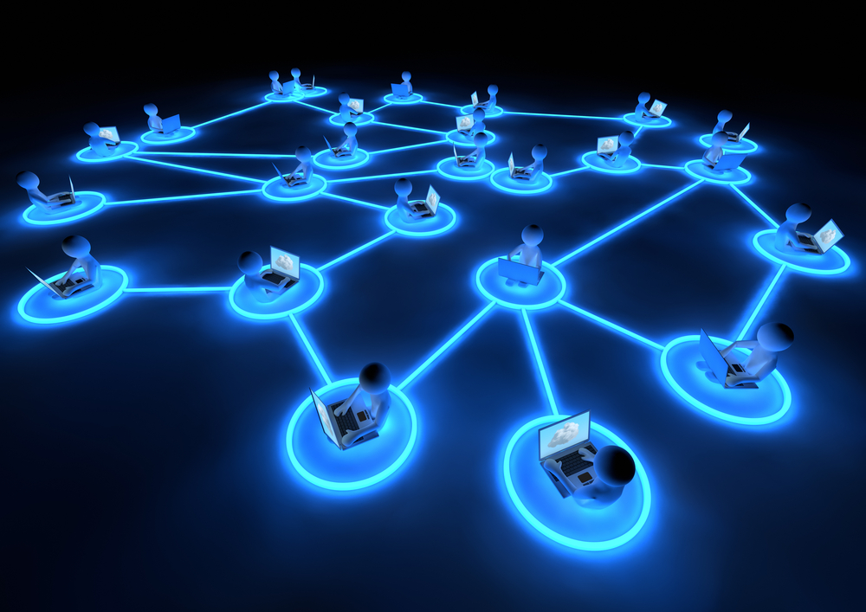
Networking I
Connecting to the world via a computer network is now a ubiquitous part of daily life. You are most likely doing it right now to attend this class.
This week we will learn how to interact with other computers over the network.
We will be exploring the basics of networking including:
URLs and URLConnection
TCP
Client Sockets
Server Sockets
UDP
Multi-threaded Servers
Today we will focus on the general principles behind networking and start to explore TCP/IP communications.
It is difficult to imagine life without computer networks. This week we'll start to explore how to use them in your code.

Slide 3
Exceptions, IO, and Threads
Exceptions come in two basic types:
Unchecked exceptions that do not need to be handled
Checked exceptions that must be rethrown or handled with a try/catch
Data comes in two basic types:
Text - ASCII characters
Bytes - positive 8-bit integers
IO is handled by two kinds of objects:
Readers/Writers work with character data
Input/Output Streams work with bytes
Threads allow a program to do more than one thing at the same time
Believe it or not, there is a method to what can feel like the madness of SoftDev II.
We teach exceptions when we do because exception handling is an important part of IO and Threads.
We teach IO when we do because reading and writing data is an important part of programming.
We teach Threads when we do because concurrent programming is also a necessary skill.
And once you have all of those tools in your toolbox, you are finally ready for networking!

Slide 4

Networking
A network comprises the hardware and software that provides two or more computers with the ability to communicate with each other
Provided that one computer is listening, another computer can establish a connection
Both computers can then send and receive data over the connection
The data may be characters or binary data (bytes)
Hi there.
Hello!
Notes:
We all use networking every day, the Internet. This week we'll touch on some of the fundamentals needed to utilize that resource in your code.
Listening & Connecting → MyCourses, Students connect

Slide 5
Protocol Layers
Protocol layering is a common technique to simplify network designs by dividing them into functional layers
For example, it is common to separate the functions of data delivery and connection management into separate layers
Each layer has its own protocol(s)
Each layer performs a specific purpose, and doesn’t need to know about the other layers or how to perform their purposes
There are two major layered protocol designs in use today.
The DoD 4-Layer model
The OSI 7-Layer model
Application
Presentation
Session
Transport
Network
Data Link
Network Access
Notes:
Here is the purpose of each OSI protocol layer in one sentence:
Application Layer – Provides network services directly to end-user applications and associated communication method (such as web browsers (HTTP), email clients (SMTP), and file transfer programs(FTP).
Presentation Layer – Translates, encrypts, and compresses data so it can be understood by the receiving system.
Session Layer – Establishes, manages, and terminates communication sessions between applications on different devices.
Transport Layer – Ensures reliable or efficient delivery of data between devices by controlling segmentation, error recovery, and flow control.
Network Layer – Determines the best path for data to travel across networks and handles logical addressing (such as IP addresses).
Data Link Layer – Provides reliable data transfer between two directly connected devices and handles physical addressing (MAC addresses) and error detection.
Network Access Layer (Physical + Data Link in TCP/IP) – Handles the physical transmission of bits over the network hardware such as cables, switches, and network interfaces.

Slide 6
Network Models at a Glance
Application
Application
Application
Presentation
Session
Transport
Transport
TCP
UDP
Internet
Network
IP
Network Access
Data Link
Ethernet
Token Ring
Frame Relay
ATM
Physical
The Department of Defense (DoD) 4-Layer model. Also called the TCP/IP Model
The Open Systems Interconnection (OSI) 7-Layer Model.
TCP/IP is the main communications protocol used by the internet. It runs in the Transport and Network layers.
Notes:
Here is the purpose of each OSI protocol layer in one sentence:
Application Layer – Provides network services directly to end-user applications and associated communication method (such as web browsers (HTTP), email clients (SMTP), and file transfer programs(FTP).
Presentation Layer – Translates, encrypts, and compresses data so it can be understood by the receiving system.
Session Layer – Establishes, manages, and terminates communication sessions between applications on different devices.
Transport Layer – Ensures reliable or efficient delivery of data between devices by controlling segmentation, error recovery, and flow control.
Network Layer – Determines the best path for data to travel across networks and handles logical addressing (such as IP addresses). [routing, forwarding, and addressing]
Data Link Layer – Provides reliable data transfer between two directly connected devices and handles physical addressing (MAC addresses) and error detection. It manages data frames, which are digital signals encapsulated into data packets. Flow control and error control of data are often key focuses of the data link layer.
Network Access Layer (Physical + Data Link in TCP/IP) – Handles the physical transmission of bits over the network hardware such as cables, switches, and network interfaces. At its core, data communication is the transfer of digital and electronic signals through various physical channels like fiber-optic cables, copper cabling, and air.

Slide 7
TCP/IP
TCP/IP is the most widely used communications protocol on the internet
It is actually two protocols working together
The Internet Protocol (IP) runs in the network layer and handles routing and relaying packets of information
The Transmission Control Protocol (TCP) establishes connections between two computers and helps to ensure that packets are delivered in order, reliably, and without corruption
Most of what we will be talking about today will be how to send and receive data between two processes (on the same or different computers) using TCP/IP
Brad?
Janet?
Before one computer can communicate with another, it needs to find the other computer on the network using its address.
Notes:
Ipconfig /all
Nslookup → DNS lookup

Slide 8
Internet Protocol Addresses
Every Internet-connected system must have a unique IP address
IPv4 uses a 32-bit (4-byte) binary number, typically represented as a “dotted quad,” e.g. 129.21.22.196
Each integer ranges from 0 to 255
The relatively small size of an IPv4 address limits the number of computers that can be connected to the Internet
Because of this, many computers on private networks are connected to the Internet through a single router or proxy
Only the router gets an Internet IP address
The other computers use private addresses, e.g. 192.168.0.100
There are several different classes that determine how the bits in the address are used...
0
Net ID (7-bits)
Address
(24-bits)
Class A
(16 million unique addresses)
10
Net ID (14-bits)
Address
(16-bits)
Class B
(65 thousand unique addresses)
110
Net ID (21-bits)
Address
(8-bits)
Class C
(254 unique addresses)
Notes:
Ipconfig /all
Total IPv4 Address space : 4,294,967,296
Size of IPv6 Address
An IPv6 address is 128 bits long.
Total possible addresses:
$2^{128}$
Total IPv6 Address Space
$2^{128}=340,282,366,920,938,463,463,374,607,431,768,211,456$
That is approximately:
340 undecillion addresses or 3.4 × 10³⁸ addresses
Example IPv6 Address
2001:0db8:85a3:0000:0000:8a2e:0370:7334
Class
First Octet Range
Default Mask
Networks
Hosts per Network
A
1–126
255.0.0.0
126
16,777,214
B
128–191
255.255.0.0
16,384
65,534
C
192–223
255.255.255.0
2,097,152
254

Slide 9
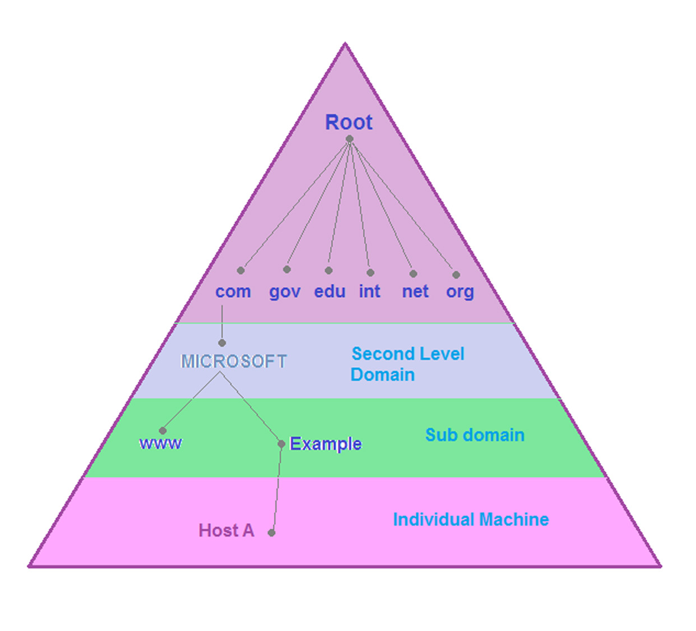
Hostnames & DNS
The IP address is ultimately used to send and receive data to and from a computer
But it is often the case that a computer is identified by its human readable hostname rather than its machine address
This is particularly the case when the network uses the dynamic host control protocol (DHCP), and a computer’s address may change at any time
A domain name server (DNS) on the network provides a service that maps a hostname to real address for the computer
A hostname is used to look up the address before trying to communicate
DNSs on the internet are arranged into a hierarchy, with the root servers at the top and individual machines at the bottom.
Notes:
Nslookup → mycourses.rit.edu
Se.rit.edu
ipconfig /displaydns
Ipconfig /flushdns

Slide 10
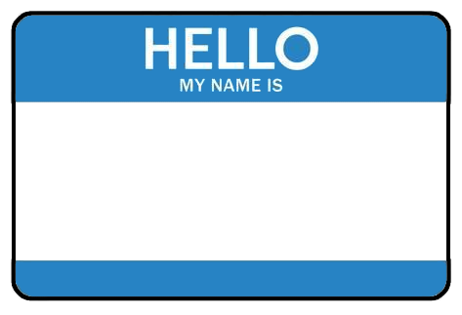
InetAddress
The java.net.InetAddress class is a class that represents internet addresses
It provides static methods that can be used to obtain the InetAddress for some hostname or IP Address
getByName(String host) - gets the InetAddress for the specific hostname or IP address
getLocalHost() - gets the InetAddress for the local computer
Once created, an InetAddress provides a few useful methods:
getHostAddress() - returns the IP address as a String
getHostname() - returns the hostname
LOCALHOST
There is a special address that always refers to the local computer called the loopback address: 127.0.0.1.
There is also a special hostname that refers to the local computer: localhost
Using either of these can be a shortcut to refer to the local computer (rather than its real address or hostname).

Slide 11
9.1
InetAddress
The InetAddress class can be used to create an object that represents the internet address of some internet-connected computer, including the local host. Try it now!
InetAddress host =
InetAddress.getLocalHost();
String hostname =
host.getHostName();
String address =
host.getHostAddress();
In the activities package, create a new PrintHostInfo class.
Use InetAddress to get the address of your computer (getLocalHost()).
Print your computer's host name and address on separate lines.
nitron.se.rit.edu
129.21.208.2

Slide 12
9.2
(Some) Networking Vocabulary
Fill in the best term for each definition to the right.
 | The term for the software and hardware that allows computers to communicate.
 | A 32-bit number used to identify a computer on a network.
 | The network layer protocol responsible for routing and relaying packets of data on the internet.
 | The transport layer protocol that insures that packets are delivered in order, reliably and without corruption.
 | A human-readable identifier for a computer.
 | The special name that always refers to the local computer.
 | The term for the address, 127.0.0.1, that always refers to the local computer.
 | A server used to translate names into addresses.
 | The older 4-layer network model.
 | The more widely used 7-layer network model.

Slide 13
9.2
(Some) Networking Vocabulary
Fill in the best term for each definition to the right.
network
 | The term for the software and hardware that allows computers to communicate.
 | A 32-bit number used to identify a computer on a network.
 | The network layer protocol responsible for routing and relaying packets of data on the internet.
 | The transport layer protocol that insures that packets are delivered in order, reliably and without corruption.
 | A human-readable identifier for a computer.
 | The special name that always refers to the local computer.
 | The term for the address, 127.0.0.1, that always refers to the local computer.
 | A server used to translate names into addresses.
 | The older 4-layer network model.
 | The more widely used 7-layer network model.
IP address
internet protocol (IP)
transmission control protocol (TCP)
hostname
localhost
loopback address
domain name server (DNS)
DoD
OSI

Slide 14
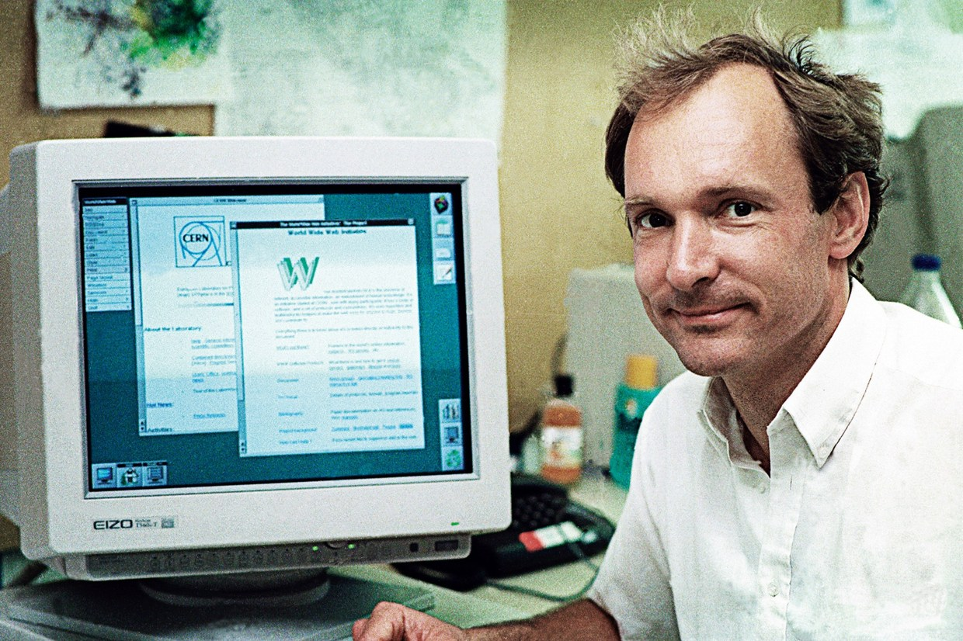
The World Wide Web
In 1989, Tim Berners Lee proposed the World Wide Web
It was designed to allow people to work together by combining their knowledge in a web of hypertext documents
A hypertext document is a document that contains links to other documents
The Hypertext Transfer Protocol (HTTP) defines several different methods that a client can call on a server
These include operations like GET, POST, and DELETE
The client always initiates communication by sending the server a request
The server always responds
HTTP and HTML are both text-based, which means that, while they are meant for machines to interpret, they are human readable.
That makes HTTP an easy example protocol to learn because you can see and understand the messages.
Notes:
MyCourses as an example.

Slide 15
URLs
A Uniform Resource Locator (URL) defines the unique location of a resource on the web in the following way:
service://host:port/file and resource details
For example:
http://www.se.rit.edu:80/~gcis-124/StyleExample.java
The service or protocol used to access the resource. In this case, HTTP (hypertext transfer protocol).
The port number to connect to. Computers may listen for requests on many different ports numbered 0-65,535.
The hostname (or IP address) of the machine that provides the resource.
The path to the resource being requested from the server.
Notes:
Default http : 80, https: 443
In HTTP protocol, Addressing is by using URL

Slide 16
URL & URLConnection
The java.net.URL class represents a URL in Java. A URL can be created with a string:
URL u = new URL("http://nasa.gov/");
The first part of the URL string identifies the protocol that should be used to communicate with the resource
There are several, e.g. HTTP, HTTPS, and FTP
If Java does not understand the protocol, a checked MalformedURLException will be thrown
The openConnection() method returns a URLConnection, which provides many methods, e.g.:
connect() - establishes a connection to the resource
getInputStream() - returns an InputStream that can be used to read data from the resource (e.g. HTML)
getOutputStream() - returns an OutputStream that can be used to write data to the resource
Each protocol defines its own message format for sending and receiving data.
Because of this, URLConnection is an abstract class. Its subclasses provide implementations for many of its methods.
e.g. HTTPURLConnection implements the HTTP protocol, and provides a few more HTTP-specific methods.

Slide 17
A Closer Look at URL & URLConnection
1 public static void main(String[] args) throws IOException {
2 URL url = new URL("https://www.nsa.gov");
3
4 URLConnection connection = url.openConnection();
5 connection.connect();
6
7 InputStream in = connection.getInputStream();
8
9 Scanner scanner = new Scanner(in);
10
11 while(scanner.hasNext()) {
12 System.out.println(scanner.nextLine());
13 }
14
15 scanner.close();
16 }

Slide 18
A Closer Look at URL & URLConnection
There is more than one way to create a URL, but the easiest is to use a string.
1 public static void main(String[] args) throws IOException {
2 URL url = new URL("https://www.nsa.gov");
3
4 URLConnection connection = url.openConnection();
5 connection.connect();
6
7 InputStream in = connection.getInputStream();
8
9 Scanner scanner = new Scanner(in);
10
11 while(scanner.hasNext()) {
12 System.out.println(scanner.nextLine());
13 }
14
15 scanner.close();
16 }
Once you have created a URL you can use it to open a URLConnection and connect it to the resource..
The InputStream can be used with a Scanner or a BufferedReader (just like a file).
Once connected, the URLConnection can be used to get an InputStream to read the resource on the other end of the connection.

Slide 19
9.3
URLConnection
The URL and URLConnection classes can be used to connect to and read any resource available on the public internet, including HTML pages, images, video, and sound. Use the classes to open a connection to your favorite search engine and print the front page to standard output. The output will be formatted as HTML and may not make a lot of sense to you.
public static void main(String[] args)
throws IOException {
URL url = new URL("https://www.nsa.gov");
URLConnection connection = url.openConnection();
connection.connect();
InputStream in = connection.getInputStream();
Scanner scanner = new Scanner(in);
while(scanner.hasNext()) {
System.out.println(scanner.nextLine());
}
scanner.close();
}
In activities, create a new "SearchPrinter.java" file
Use the URL class to print the landing page from your favorite search engine
I.E. https://search.yahoo.com, https://www.google.com, https://www.bing.com, etc.
Start by forming a connection with the URL using openConnection() and connect()
Then get an InputStream from the connection, wrap it in a BufferedReader, and print out all the lines returned
This would be a great time to refresh your memory on using Streams to work with data.

Slide 20
TCP/IP Connections With Sockets
URL and URLConnection are fine for communicating using established internet protocols like HTTP
But what if you want to establish your own TCP/IP connection to send and receive data using some other protocol (e.g. one of your own design)?
The java.net.Socket class is used to establish a TCP/IP connection to a specific hostname (or IP address) and port
Socket sock =
new Socket("localhost", 1234);
Once established, the socket can be used to send or receive data to/from the other computer
We’ll discuss exactly how to send and receive data presently
A socket connection can only be established to a port on which the other computer is actively listening for connections.
Trying to connect to a port that is not being used to listen for connections will cause an error.
In fact, pretty much everything you do with a socket might throw a checked exception.
The good news is that all of the exceptions extend IOException, and so that is the only one that you really need to handle.

Slide 21
9.4
Open a Socket
A Java Socket establishes a TCP/IP connection to some host on a specific port. Let's practice by opening Sockets to several different host and port combinations.
Create a new Connector class in Connector.java
Define a main method and use it to create a Socket to the following hosts/ports one at a time:
www.google.com/80
www.npr.org/443
gcis-124.rit.edu/33075
Don't forget to close the socket(s) after opening!
Socket sock =
new Socket("localhost", 1234);
socket.close();
What if the computer that you are trying to connect to is not listening on the specified port?
What will happen if a computer with that name doesn’t exist?
Notes:
What will happen if a computer with that name doesn’t exist? ➔ You will get error.

Slide 22


Sending Data
Once a connection is established, both sides of the connection are represented as Sockets
The getOutputStream() method will return an OutputStream that can be used to send data to the other end of the connection
Recall that Java streams are used to send binary data. If text data is preferred, the OutputStream may be wrapped in an instance of the java.io.PrintWriter class
PrintWriter writer =
new PrintWriter(stream);
methods:
println(String) - writes a string of text terminated with a newline
write(char[]) - writes a character buffer
flush() - sends any buffered data to the other side
A PrintWriter provides lots of useful
It can be helpful to think of the two ends of the connection like a telephone.
Hello!
Audio sent through the microphone (output stream) on one end...
...is heard through the speaker (input stream) on the other.
Hello!

Slide 23
Using PrintWriter to Send Data
1 Socket client = new Socket("somehost.net", 54321);
2 OutputStream out = client.getOutputStream();
3 PrintWriter printer = new PrintWriter(out);
4 printer.println("John Denver");
5
6 printer.flush();
7 client.close();

Slide 24
Using PrintWriter to Send Data
A socket's OutputStream can send data as bytes or byte arrays. It can be difficult to use, especially when sending text data.
It is more efficient to send large "chunks" of data than it is to send lots of little messages over the network. Because of this, a socket will buffer the data until it is flushed.
1 Socket client = new Socket("somehost.net", 54321);
2 OutputStream out = client.getOutputStream();
3 PrintWriter printer = new PrintWriter(out);
4 printer.println("John Denver");
5
6 printer.flush();
7 client.close();
A PrintWriter can wrap an OutputStream and can be used to send strings easily using its println(String) method.
If you forget to flush, the data will never be sent over the socket!
Notes:
Simple Definition (one line)
A socket is a combination of an IP address and a port number that allows two programs to send and receive data over a network.
How to Think About It
Think of a socket like a phone connection:
IP address → phone number (which device)
Port number → extension (which application)

Slide 25
9.5
Sending Data
A Socket can be used to send bytes of data to the computer at the other end of the connection, but we'll mostly be working with characters and strings in this unit. Let's practice using a PrintWriter to send strings of data over a TCP/IP connection.
Your instructor will be running the server ...
Create a new "Name.java" file
Using a Socket, form a connection with the IP address and port number that will be provided by your instructor
Create a PrintWriter for the Socket's OutputStream
Write your name using the Socket
and displaying its output on the screen/projector.
Check the screen to see if you were able to connect and send your name.
Socket client = new Socket("somehost.net", 54321);
OutputStream out = client.getOutputStream();
PrintWriter printer = new PrintWriter(out);
printer.println("John Denver");
printer.flush();
client.close();
Who will be first?
Notes:
Port numbers are 16-bit unsigned integers.
Minimum value: 0
Maximum value: 2¹⁶ − 1 = 65535
RangeNamePurpose
0 – 1023 Well-known portsReserved for common services (HTTP, FTP, etc.)
1024 – 49151 Registered ports Used by applications
49152 – 65535 Dynamic / Ephemeral portsTemporary ports used by clients

Slide 26
Receiving Data
Once a connection is established, both sides of the connection are represented as Sockets
The Socket::getInputStream() method will return an InputStream that can be used to receive data from the other end of the connection
Recall that Java streams are used to read binary data. If text data is preferred, the InputStream may be wrapped in an instance of the java.io.BufferedReader class
BufferedReader sc = new
BufferedReader(inputStream);
Remember, a BufferedReader provides useful methods, including:
readLine() - reads up to the next newline
lines() - interprets the received data as a Stream of lines.
It can be helpful to think of the two ends of the connection like a telephone.
Hello!
Audio sent through the microphone (output stream) on one end...
...is heard through the speaker (input stream) on the other.
Hello!

Slide 27
Using BufferedReader to Read Data
1 InputStream input = client.getInputStream();
2 InputStreamReader in = new InputStreamReader(in)
3 BufferedReader reader = new BufferedReader(input);
4 String message = reader.readLine();
5 System.out.print(message);
6 client.close();
7 System.out.println();

Slide 28
Using BufferedReader to Read Data
A socket's InputStream can only read data as bytes or byte arrays and can be difficult to use when reading strings.
1 InputStream input = client.getInputStream();
2 InputStreamReader in = new InputStreamReader(in)
3 BufferedReader reader = new BufferedReader(input);
4 String message = reader.readLine();
5 System.out.print(message);
6 client.close();
7 System.out.println();
If the InputStream is wrapped inside of an InputStreamReader, it can be used to make a Buffered.
Once you've created the BufferedReader, the readLine() methods can be used to read text. This method will block until there is data to read.

Slide 29
Reading Multiple Lines With a Do While.
Ever wanted to do an operation 1+ times? We can use a do while statement for this.
1 InputStream input = client.getInputStream();
2 InputStreamReader in = new InputStreamReader(in)
3 BufferedReader reader = new BufferedReader(input);
5 do {
6 String message = in.readLine();
7 System.out.print(message);
8 } while (in.ready());
9 client.close();
10 System.out.println();
It's basically a while statement where the check is executed at the end instead of the beginning. The block is started with do.
This code reads all available lines and concatenates them together into one String.
We could just have easily used a list.add(message) to create a list of all the messages.
Notes:
✅ Better Version (Recommended)
String message; while ((message = reader.readLine()) != null) { System.out.println(message); }
Why this is better:
Keeps reading until the stream is closed
No data loss
Standard pattern for sockets/files

Slide 30
What About Streams
We used BufferedReader in part to give us access to the data as a Stream, how would that work?
1 InputStream input = client.getInputStream();
2 InputStreamReader in = new InputStreamReader(in)
3 BufferedReader reader = new BufferedReader(input);
4 in.lines().forEach(System.out::println);
5 client.close();
6 System.out.println();
Once we have the lines() from the reader, we can use whatever Stream operations we would like.
In this example, we used forEach to print out each line.
BufferedReader.lines() waits for the InputStream to close before reading. This means it is somewhat situational but works for many standard scenarios.
Notes:
Corrected version
InputStream input = client.getInputStream(); InputStreamReader in = new InputStreamReader(input); BufferedReader reader = new BufferedReader(in); reader.lines().forEach(System.out::println); client.close(); System.out.println();

Slide 31
9.6
Receiving Data
The NIST server provides a server that can be used to get the current time. Let's write a program that uses a TCP/IP socket to connect to the service and read the time.
The readLine() method on BufferedReader blocks until it sees a newline. But the NIST time service doesn't send a newline! However, lines() will still work.
Add a new NetworkTime class to your project
Establish a TCP connection with the server "time.nist.gov" on port 13
Use a BufferedReader to read the InputStream from the Socket
Since the server does not send a new line, we'll need to use the lines() stream.
lines() breaks the Stream up by new lines but also sends any data that is available when the InputStream closes as a final line.
Print all the information in lines().
Hint, it will be a single line.
Example: 59314 21-04-10 23:24:16 50 0 0 196.4 UTC(NIST) *
Don't forget to close the Socket.
InputStream input = client.getInputStream();
InputStreamReader in = new InputStreamReader(in)
BufferedReader reader = new BufferedReader(input);
in.lines().forEach(System.out::println);
client.close();
System.out.println();
Repeated connection attempts faster than 4 seconds will result in an IP ban (don't do that)

Slide 32
Review: TCP/IP With Sockets
URL and URLConnection are fine for communicating using established internet protocols like HTTP
But what if you want to establish your own TCP/IP connection to send and receive data using some other protocol (e.g. one of your own design)?
The java.net.Socket class is used to establish a TCP/IP connection to a specific hostname (or IP address) and port
Socket sock =
new Socket("localhost", 1234);
Once established, the socket can be used to send or receive data to/from the other computer using the getOutputStream() and getInputStream() methods on the socket.
A socket connection can only be established to a port on which the other computer is actively listening for connections.
Trying to connect to a port that is not being used to listen for connections will cause an error.
In fact, pretty much everything you do with a socket might throw a checked exception.
The good news is that all of the exceptions extend IOException, and so that is the only one that you really need to handle.

Slide 33
Listening for Connections
Before a client can connect to a server, the server must begin listening for incoming connections on an available port
The port is a positive number between 1 and 65,535
Many ports are in use by the operating system or are reserved (most of the ports below 1500)
The java.net.ServerSocket class can be used to listen for TCP/IP connections on a specified port
ServerSocket s =
new ServerSocket(12345);
The accept() method will block until a client establishes a connection
It returns a Socket that can be used to communicate with the client, i.e. by using the Socket’s input and output streams.
In networking, the server is the host listening for incoming connections and the client establishes the connection.
It is usually the case that the server is providing some useful service that the client would like to use.
In Java, once a connection is established, both ends of the connection are represented as Java Sockets.
This means that both the client and server send and receive data in the same way.

Slide 34
9.7
Listening for Connections
A computer must be listening for incoming connections on a specific port before another process on the same or a different computer can connect to it. The mechanism for doing this in Java is the ServerSocket. Write the code to listen for incoming connections on port 22.
What will happen if the specified port is already in use?
In activities, create a new class named "Listener".
Using a ServerSocket listen for connections on port 22.
When a connection is accepted, print the received message and close the connection.
Run your code and use verify it waits for a connection.
You don't actually need to make a connection right now.
You can use ssh localhost to test your server if you would like to.
ServerSocket server = new ServerSocket(portnum);
Socket client = server.accept();
System.out.println("Connected!");
client.close();

Slide 35
Review: Sending Data
Once a connection is established, both sides of the connection are represented as Sockets
The getOutputStream() method will return an OutputStream that can be used to send data to the other end of the connection
Recall that Java streams are used to send binary data. If text data is preferred, the OutputStream may be wrapped in an instance of the java.io.PrintWriter class
PrintWriter writer =
new PrintWriter(stream);
A PrintWriter provides lots of useful methods:
println(String) - writes a string of text terminated with a newline
write(char[]) - writes a character buffer
flush() - sends any buffered data to the other side
It can be helpful to think of the two ends of the connection like a telephone.
Hello!
Audio sent through the microphone (output stream) on one end...
...is heard through the speaker (input stream) on the other.
Hello!

Slide 36
9.8
Sending Data
We now know how to open sockets, read data, write data, and listen for incoming connections. Let's put it all together by writing an "Echo Server" that reads data from a client and sends it back. The first step is writing the EchoClient.
Exception in thread "main" java.net.ConnectException: Connection refused: connect
at java.base/sun.nio.ch.Net.connect0(Native Method)
at java.base/sun.nio.ch.Net.connect(Net.java:574)
at java.base/sun.nio.ch.Net.connect(Net.java:563)
at java.base/sun.nio.ch.NioSocketImpl.connect(NioSocketImpl.java:588)
at java.base/java.net.SocksSocketImpl.connect(SocksSocketImpl.java:333)
at java.base/java.net.Socket.connect(Socket.java:648)
at java.base/java.net.Socket.connect(Socket.java:597)
at java.base/java.net.Socket.<init>(Socket.java:520)
at java.base/java.net.Socket.<init>(Socket.java:294)
at Day02.echo.EchoClient.main(EchoClient.java:9)
Create a new package named echo
Inside echo, add a class named "EchoClient"
Open a Socket to your "localhost" on port 54321
Use a PrintWriter to write a line of text to the Socket
Use println() to send the message so that it is terminated with a newline.
Don't forget to flush()
close the Socket
Run your program
It will fail because you don't have a server yet
One step at a time
You should get an exception similar to the above one. That is expected for now.

Slide 37
Review: Receiving Data
Once a connection is established, both sides of the connection are represented as Sockets
The Socket::getInputStream() method will return an InputStream that can be used to receive data from the other end of the connection
Recall that Java streams are used to read binary data. If text data is preferred, the InputStream may be wrapped in an instance of the java.io.BufferedReader class
BufferedReader sc = new
BufferedReader(inputStream);
Remember, a BufferedReader provides useful methods, including:
readLine() - reads up to the next newline
lines() - interprets the received data as a Stream of lines.
It can be helpful to think of the two ends of the connection like a telephone.
Hello!
Audio sent through the microphone (output stream) on one end...
...is heard through the speaker (input stream) on the other.
Hello!

Slide 38
9.9
Echo?
We're off to a good start, but the client doesn't have a server to talk to, yet. This is why you're getting a "connection refused" exception when you run the client. Let's write the server-side of this application; listen for a connection, read a message, and print it out.
1 InputStream input = client.getInputStream();
2 InputStreamReader in = new InputStreamReader(in)
3 BufferedReader reader = new BufferedReader(input);
4 String message = reader.readLine();
5 System.out.print(message);
6 client.close();
7 System.out.println();
In the echo package, create an EchoServer class
Create a ServerSocket on port 54321 and use it to listen for an incoming connection
Use a Scanner to read one line from the client socket and print it.
Run your EchoServer and then EchoClient
You should see the message from the client appear in the server's terminal!
You can also use the stream if you prefer that notation.

Slide 39
Review: A Typical Client & Server
ServerSocket server = new ServerSocket(42975);
Socket client = server.accept();
InputStream fromClient =
client.getInputStream();
OutputStream toClient =
client.getOutputStream();
Socket sock =
new Socket("ahost.rit.edu", 42975);
OutputStream toServer =
sock.getOutputStream();
InputStream fromServer =
sock.getInputStream();
The server must begin listening for connections on a specific port.
Socket
(server side)
Socket
(client side)
Next, the client must establish the connection to the server on the correct port.
Input Stream
Output Stream
Once the connection is established, the server uses streams to send/receive data to/from the client.
Once the connection is established, the client uses streams to send/receive data to/from the server.
Output Stream
Input Stream

Slide 40

9.10
Echo! Echo! Echo! …
Our EchoServer is doing a great job of listening for an incoming message, but it's not yet sending it back to the client! Let's modify the message in some way (so that we know that it made the round trip from client to server) and send it back!
In EchoServer, add a PrintWriter for the client socket
Alter the message in some way (e.g. add something to it or convert it to uppercase) and then use the PrintWriter to send it back back to the client
In EchoClient, use a BufferedReader to read lines of text from the socket's InputStream
Get the response from the server and print it
Run both applications and verify the message is returned to the client

Slide 41
9.11
Stream is Broken
If you happened to have used the lines() method in the previous activities, you will have noticed the server stopped working. This is because lines() only reads after the InputStream has closed. In the previous activity we are waiting for a response before closing the socket.
Socket client = new Socket("somehost", 54321);
OutputStream out = client.getOutputStream();
PrintWriter printer = new PrintWriter(out);
printer.println("John Denver");
printer.flush();
client.shutdownOutput();
Your initial thought might be to close() the client's OutputStream once you've sent the message.
Unfortunately this closes the entire socket so we won't be able to get the response.
Instead we'll want to use socket.shutdownOutput().
This will close only the OutputStream and send the stream termination sequence to the server.
Update your code to use lines(), if you weren't already.
After sending the message, use socket.shutdownOutput().
Run the echo server, then your client to see the server now properly gets the message and sends it back.
Only shut down the output stream after sending the message. This leave the input stream open for receiving the response.

Slide 42


Summary & Reflection
What is one thing that you wish you knew more about as we move forward?
Networking
URLs & URLConnection
TCP/IP Sockets
InputStream
OutputStream
UDP
DatagramPacket
DatagramSocket
Threads!
The Proxy Pattern
What is one new thing that you learned today?
What one question do you have about today’s class?
Please answer the questions above in your notes for today.

Slide 43
 | InetAddress java.net.InetAddress getByName(String host) getLocalHost() | getHostAddress() getHostname() | URL & URLConnection java.net.URL URL u = new URL(“http://nasa.gov/”); openConnection() getInputStream() connect() getOutputStream()
 | Sockets java.net.Socket Socket sock = new Socket(“localhost”, 1234); |  | OutputStream & PrintWriter Socket::getOutputStream() java.io.PrintWriter PrintWriter writer = new PrintWriter(stream); println(String) write(char[]) flush()
 | InputStream & Scanner Socket::getInputStream() java.util.Scanner |  | ServerSocket java.net.ServerSocket ServerSocket s = new ServerSocket(1234); accept()
 | DatagramPacket & DatagramSocket java.net.DatagramPacket java.net.DatagramSocket
Unit 12: Networking

Slide 44
A Note About Running Multiple Programs
When testing networking code you will often need to run multiple applications at the same time.
You cannot use the play button to do this in VS Code.
Instead you can use the Run and Debug activity (left bar).
Alternatively, you can run multiple instances of VS Code.

